Slide 2

Ypp 4
bbv Software Services AG | Date: 21/07/2025

Slide 3




Presentation on MS Lists Functionalities
bbv Software Services AG | Date: 21/07/2025

Slide 4
Agenda
Introduction
Key Functionalities
Q&A

Slide 5

Introduction
What is MS Lists?

Slide 6
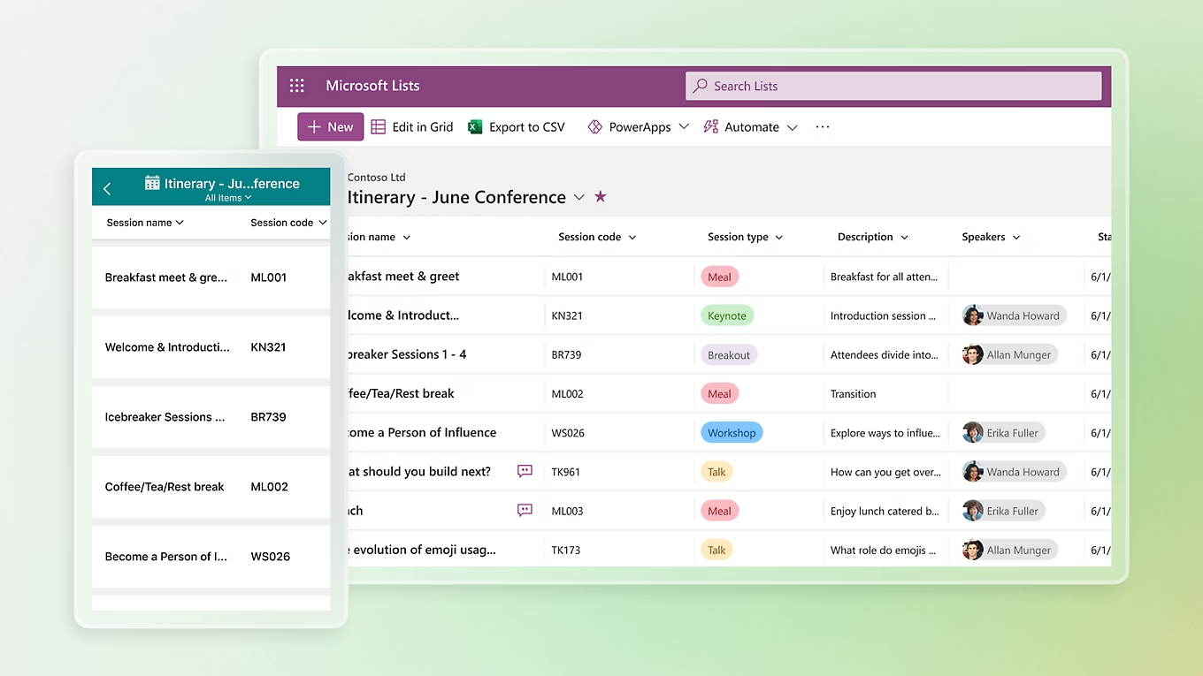
Introduction
What is Microsoft Lists
MS List is a tool for managing structured lists of data
Works like a simple table or database
Let’s users:
Create lists
View data
Manage info clearly and easily

Slide 7

Key Functionalitie

Slide 8
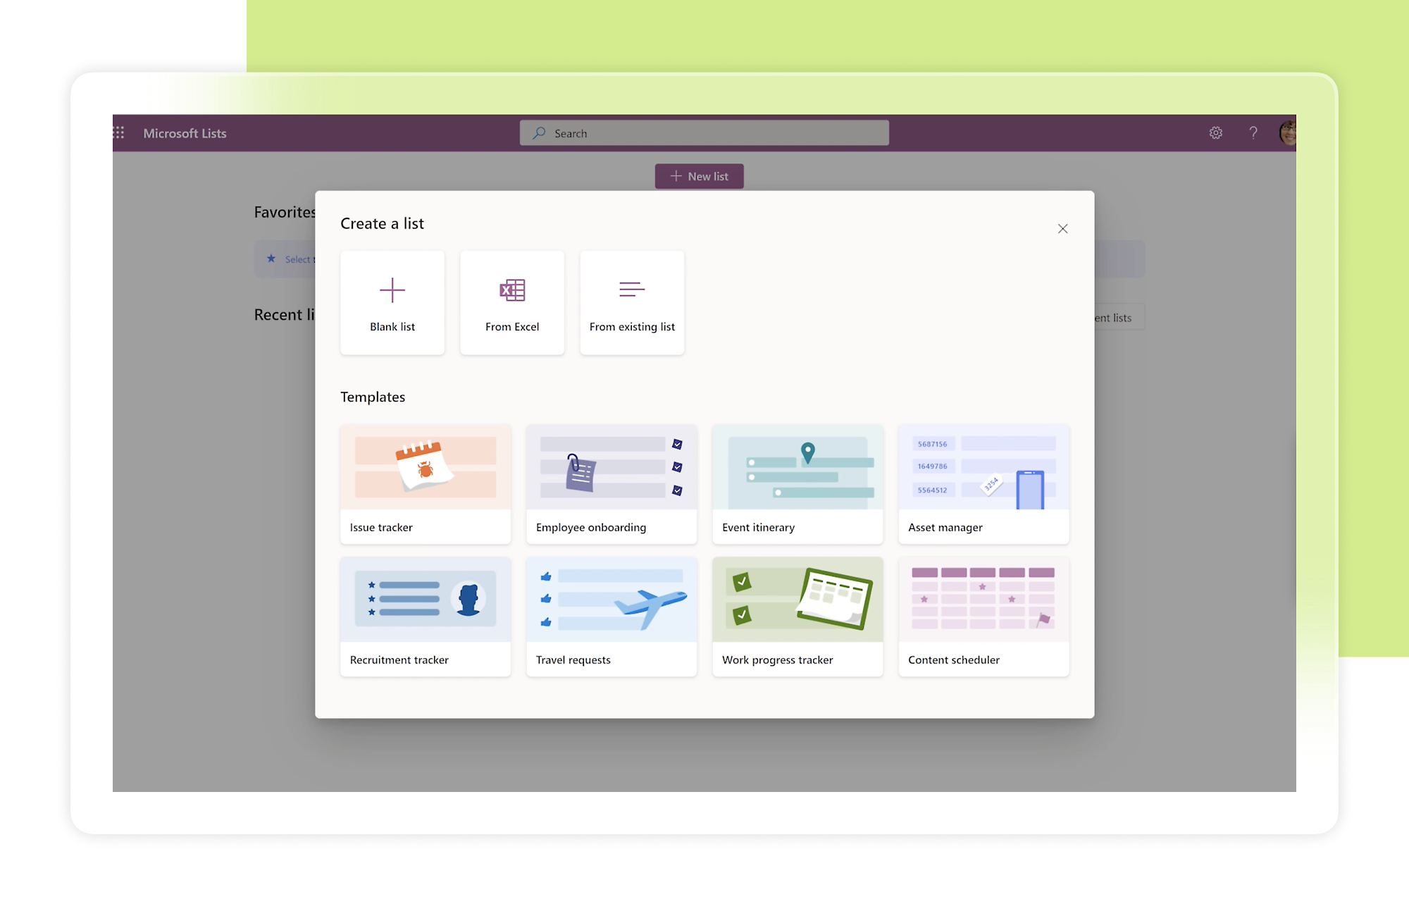
Key Functionalities of MS Lists
Create and Manage Lists
Custom Columns
Manage List Items
Custom Views
Conditional Formatting
Permissions and Sharing
Built-in Templates

Slide 9
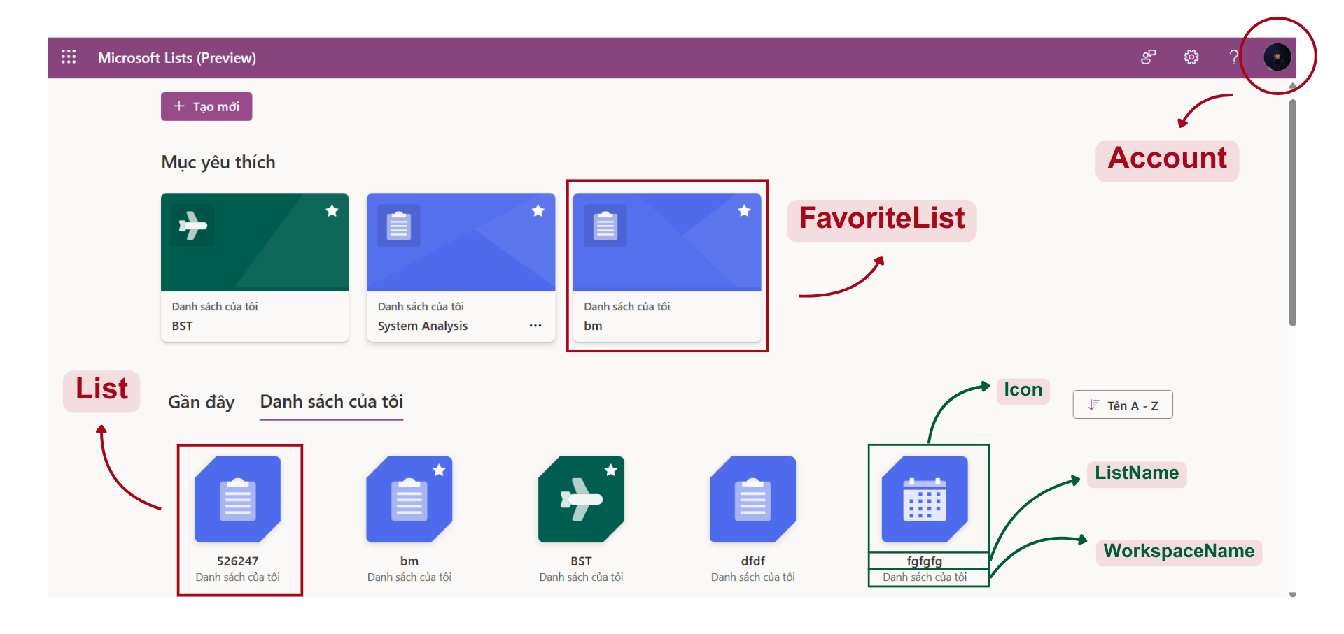
Dashboard Screen
Notes:
-- 1. Display all lists that the logged-in user created or were shared with them
DECLARE @UserId INT = 2; -- Replace with the ID of the logged-in user
SELECT DISTINCT
l.Id,
l.ListName,
l.Icon,
l.Color,
lmp.HighestPermissionCode, -- Extra
lmp.GrantedByAccountId -- Extra
FROM List l
JOIN ListMemberPermission lmp ON l.Id = lmp.ListId AND lmp.AccountId = @UserId -- JOIN is still used because the creator will be added to ListMemberPermission
WHERE l.CreatedBy = @UserId
OR lmp.Id IS NOT NULL
AND l.ListStatus = 'Active';
GO
-- 2. Display all lists that the logged-in user created
DECLARE @UserId INT = 2;
SELECT
l.ListName,
l.Icon,
l.Color
FROM List l
WHERE l.CreatedBy = @UserId
AND l.ListStatus = 'Active';
GO
-- 4. Display favorite lists of the logged-in user
DECLARE @UserId INT = 2; -- Replace with the ID of the logged-in user
SELECT
l.Id,
l.ListName,
l.Icon,
l.Color
FROM FavoriteList fl
INNER JOIN List l ON fl.ListId = l.Id
WHERE fl.FavoriteListOfUser = @UserId
AND l.ListStatus = 'Active'
ORDER BY fl.CreatedAt DESC;
GO

Slide 10
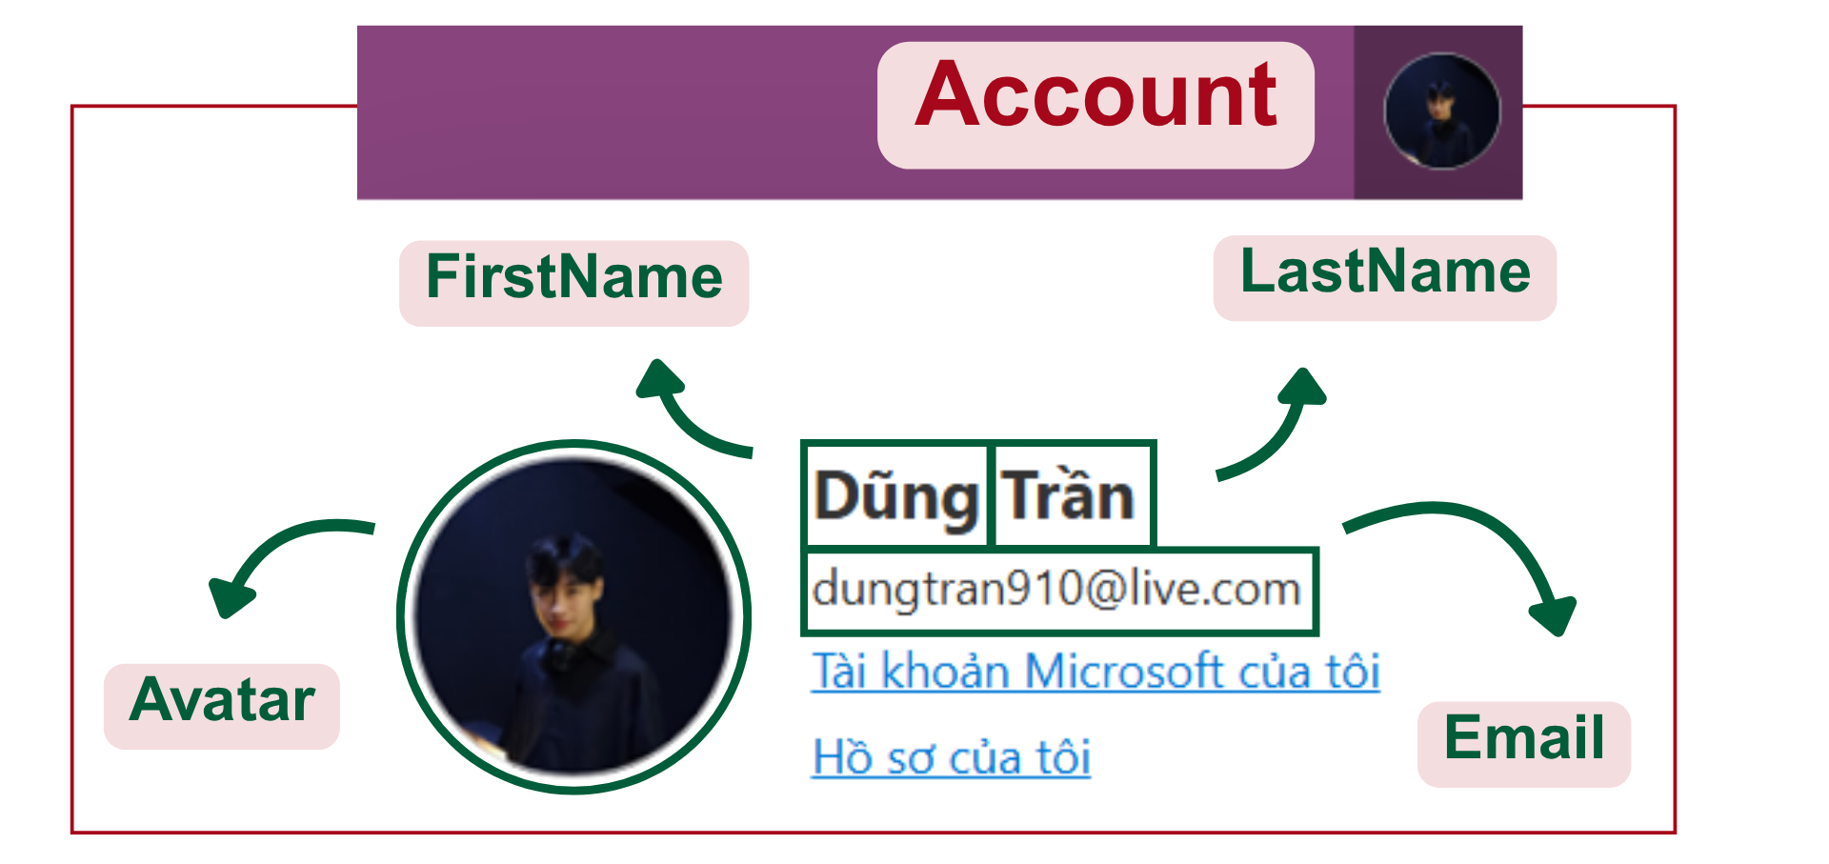
Dashboard Screen
Notes:
-- 3. Display information of the logged-in user
DECLARE @UserId INT = 2;
SELECT
a.Id,
a.FirstName,
a.LastName,
a.Avatar,
a.Email,
a.Company,
a.AccountStatus
FROM Account a
WHERE a.Id = @UserId;
GO

Slide 11
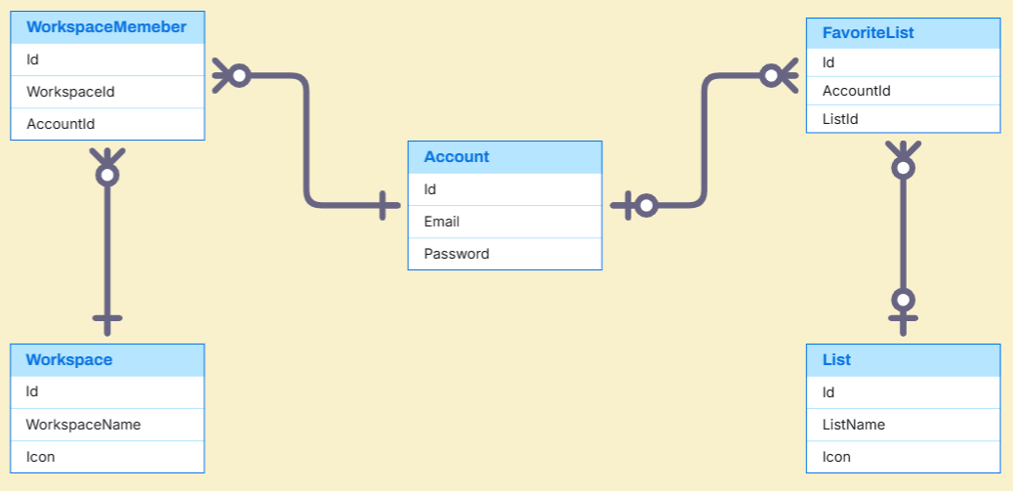
Dashboard Entities

Slide 12
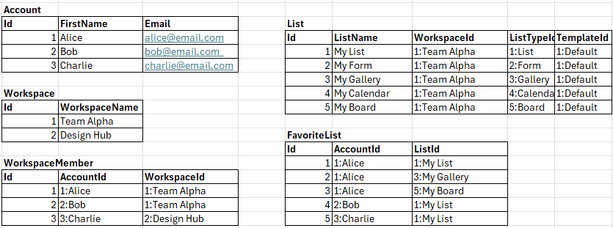
Dashboard Sample Data

Slide 13
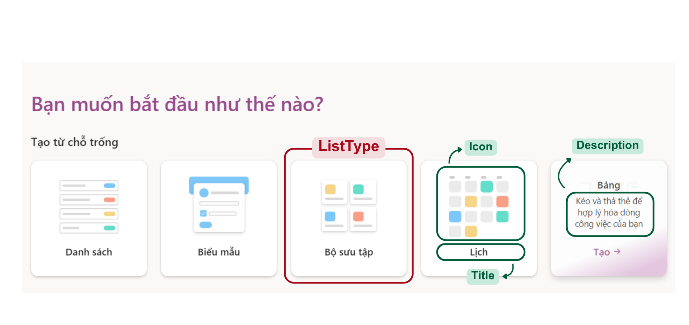
Create List Screen
Notes:
-- 1. Display all list types for selection
SELECT
Title,
ListTypeDescription,
HeaderImage
FROM ListType
ORDER BY Title;

Slide 14
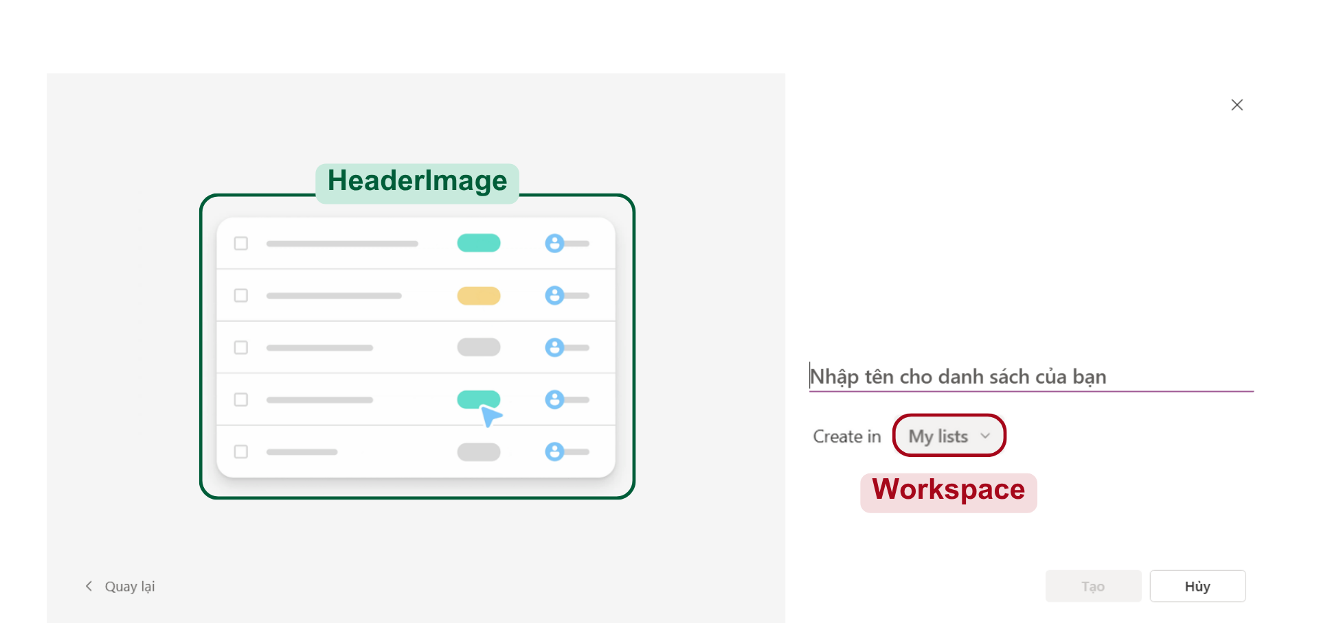
Create List From List Type

Slide 15
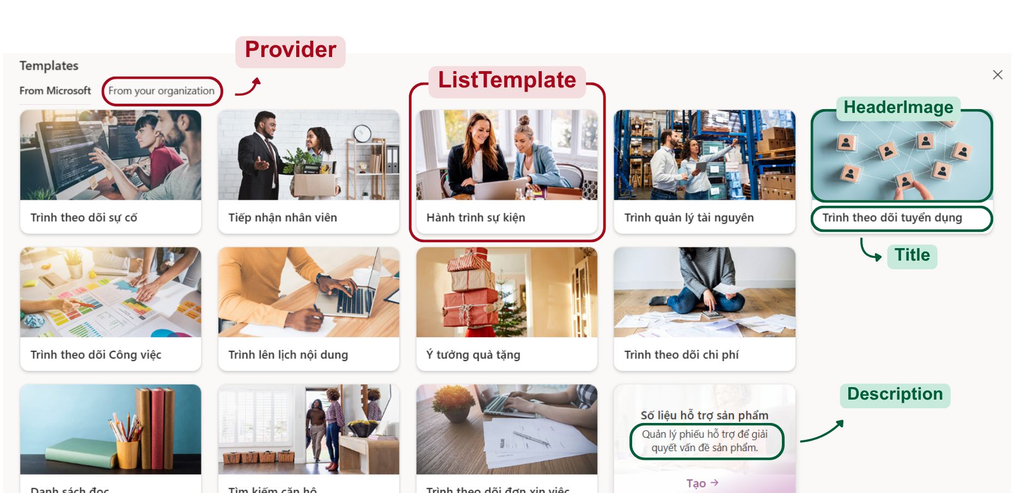
Create List Screen
Notes:
-- 2. Display all templates
SELECT
lt.Title,
lt.HeaderImage,
lt.Sumary,
pr. ProviderName
FROM ListTemplate lt
JOIN Provider pr ON lt.ProviderId = pr.Id
ORDER BY lt.Title;

Slide 16
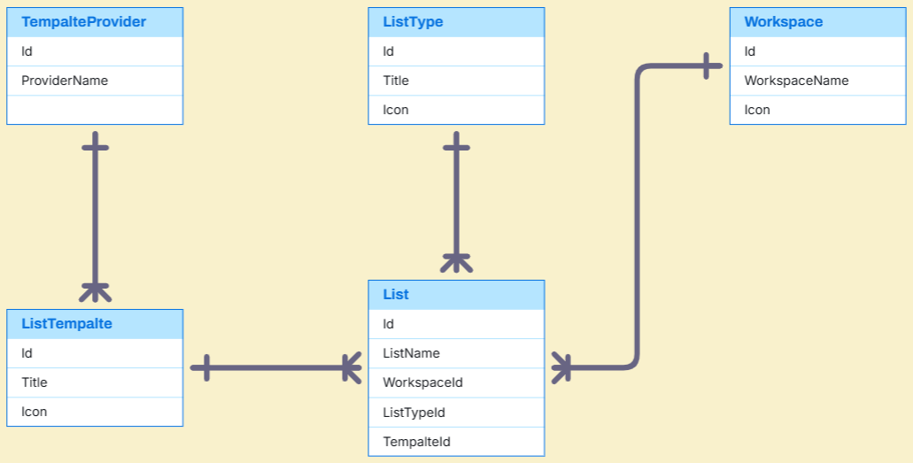
Create List Sample Data

Slide 17
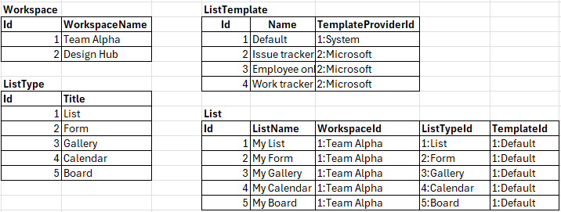
Create List Sample Data

Slide 18
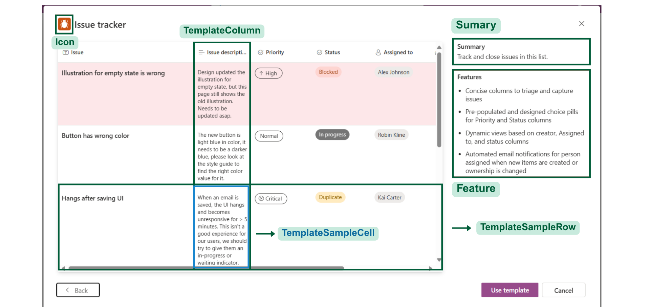
Create List From Template
Notes:
-- 2. Display information of the selected template
DECLARE @TemplateId INT = 5; -- Replace with the ID of the template to view
SELECT
lt.Title,
lt.HeaderImage,
lt.TemplateDescription,
lt.Icon,
lt.Color,
lt.Sumary,
lt.Feature
FROM ListTemplate lt
WHERE lt.Id = @TemplateId;
GO

Slide 19
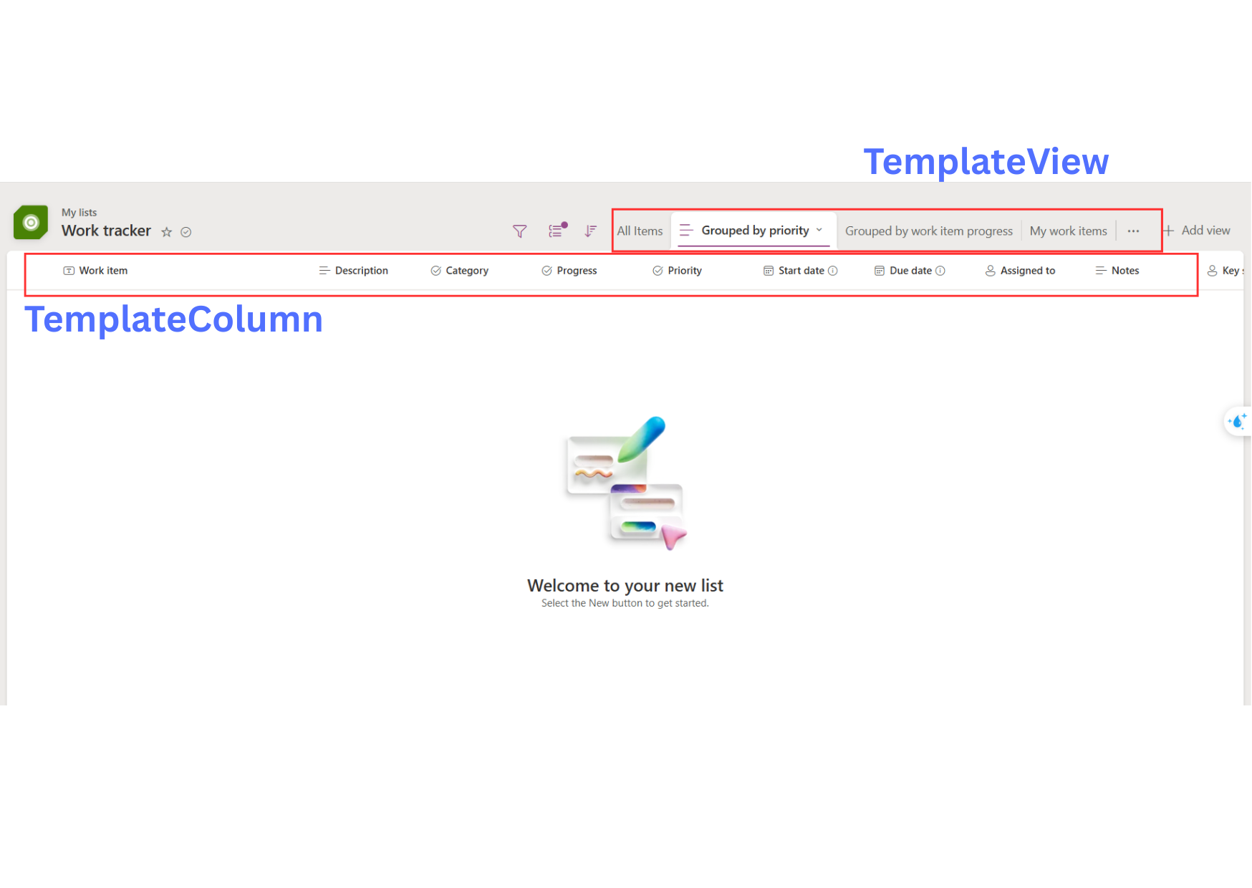
Template View & Template Column

Slide 20
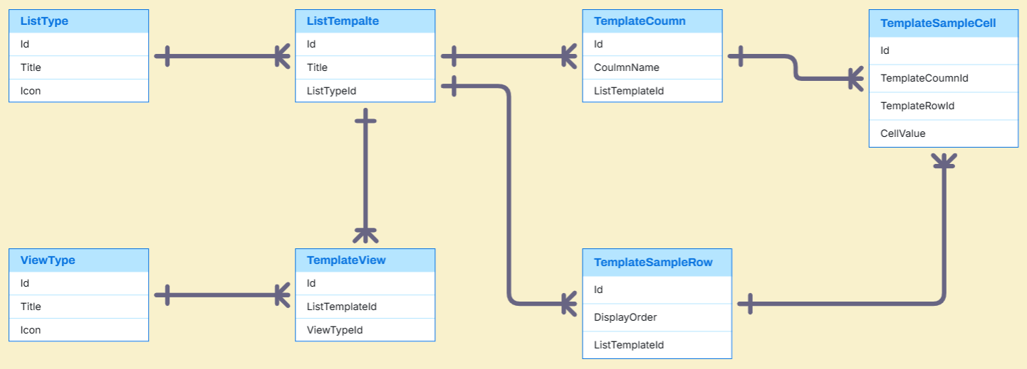
Template Entities

Slide 21
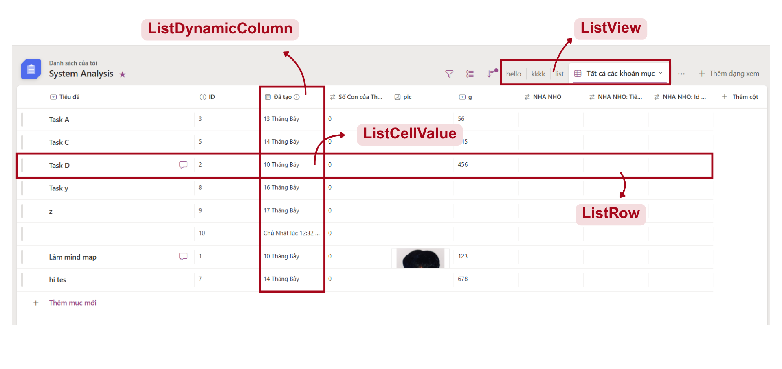
List Management
Notes:
DECLARE @UserId INT = 2;
DECLARE @ListId INT = 2;
-- Check access permission
IF EXISTS (
SELECT 1
FROM ListMemberPermission
WHERE ListId = @ListId AND AccountId = @UserId
)
BEGIN
-- User has access: show list info
SELECT
l.Id AS ListId,
l.ListName,
CASE
WHEN l.CreatedBy = @UserId THEN 'My List'
ELSE NULL
END AS Ownership,
CASE
WHEN f.Id IS NOT NULL THEN 'Yes'
ELSE 'No'
END AS IsFavorite,
'Has access' AS AccessStatus
FROM List l
LEFT JOIN FavoriteList f
ON l.Id = f.ListId AND f.FavoriteListOfUser = @UserId
WHERE l.Id = @ListId;
END
ELSE
BEGIN
-- User has no access: return notice
SELECT
NULL AS ListId,
NULL AS ListName,
NULL AS Ownership,
NULL AS IsFavorite,
'No access' AS AccessStatus;
END
GO
-- 2. Display all list views of the selected list
DECLARE @UserId INT = 2;
DECLARE @ListId INT = 2;
-- Check if the user has access
IF EXISTS (
SELECT 1
FROM ListMemberPermission
WHERE ListId = @ListId AND AccountId = @UserId
)
BEGIN
-- User has access: show all views of the list
SELECT
lv.Id,
lv.ListId,
lv.ViewName,
lv.DisplayOrder
FROM ListView lv
WHERE lv.ListId = @ListId
ORDER BY lv.DisplayOrder;
END
ELSE
BEGIN
-- User has no access
SELECT
NULL AS ListViewId,
NULL AS ViewName,
NULL AS ViewType,
NULL AS DisplayOrder,
NULL AS IsDefault,
NULL AS CreatedAt,
'No access to this list' AS AccessStatus;
END
GO -- 3. Display visible Dynamic Columns
DECLARE @ListId INT = 2;
SELECT
sd.Icon,
dc.ColumnName,
dc.IsVisible,
dc.DisplayOrder
FROM ListDynamicColumn dc
JOIN SystemDataType sd ON dc.SystemDataTypeId = sd.Id
WHERE dc.ListId = @ListId
AND dc.IsVisible = 1
ORDER BY dc.DisplayOrder;
GO

Slide 22
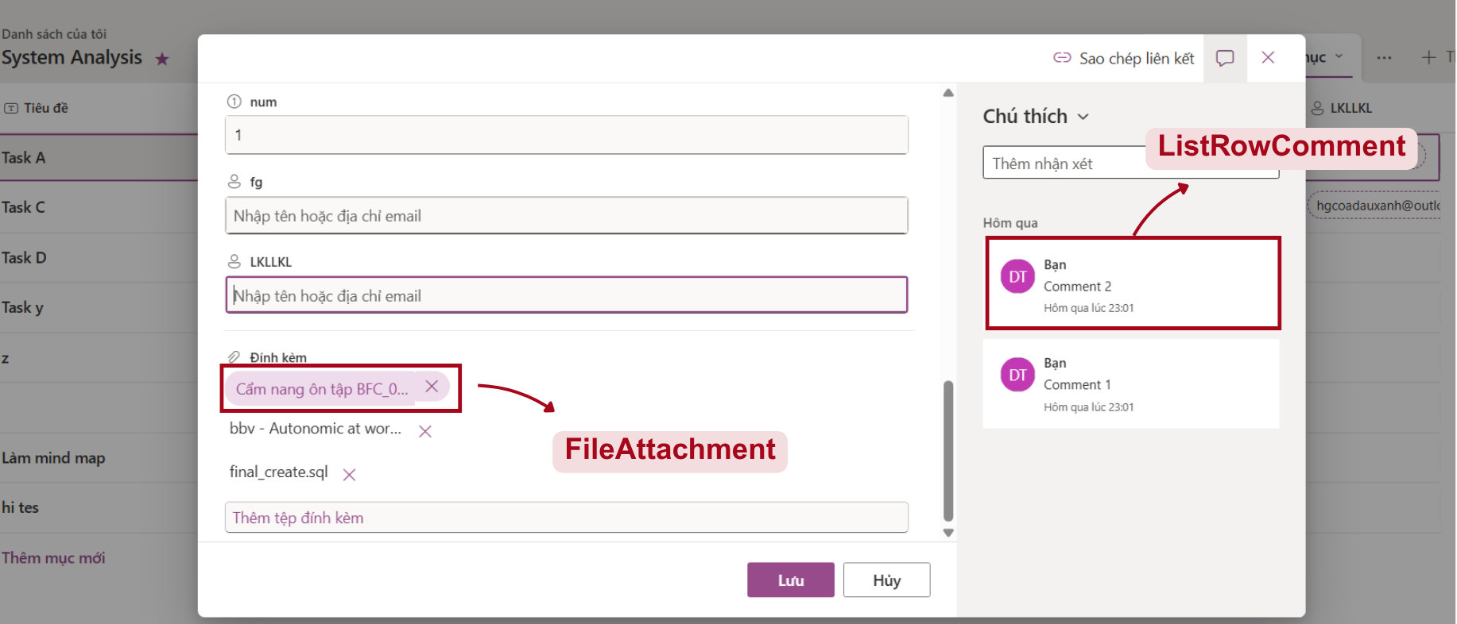
List Row Detail
Notes:
-- 1. Display the cell values for each column of the specified list row
DECLARE @ListId INT = 1;
DECLARE @ListRow INT = 1;
SELECT
ldc.ColumnName,
lcv.CellValue
FROM ListCellValue lcv
JOIN ListDynamicColumn ldc ON lcv.ListColumnId = ldc.Id
JOIN ListRow lr ON lcv.ListRowId = lr.Id
WHERE lr.Id = @ListRow
AND lr.ListId = @ListId -- đảm bảo đúng row thuộc list đó
AND ldc.ListId = @ListId -- chỉ lấy cột của list này
ORDER BY ldc.DisplayOrder;
GO
-- 2. Display the comments associated with that list row
DECLARE @ListId INT = 1;
DECLARE @ListRow INT = 1;
SELECT
a.FirstName,
a.Avatar,
lrc.Content,
lrc.CreatedAt
FROM ListRowComment lrc
JOIN Account a ON lrc.CreatedBy = a.Id
WHERE lrc.ListRowId = @ListRow

Slide 23
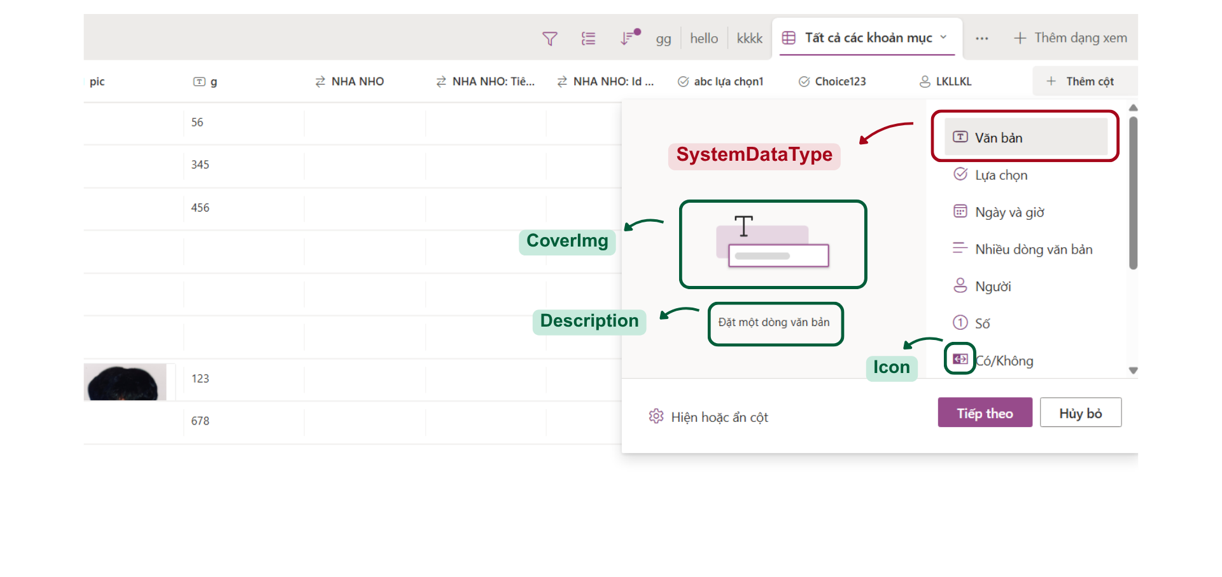
List Column
Notes:
-- 1. Display all Data Types of the Column.
SELECT
sd.CoverImg,
sd.DataTypeDescription,
sd.Icon,
sd.DisplayName
FROM SystemDataType sd
GO

Slide 24
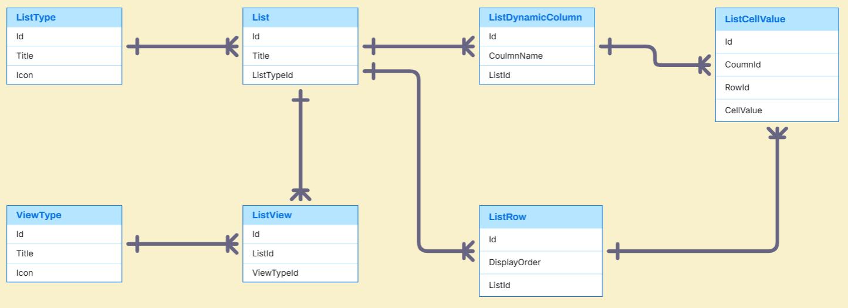
List Entities

Slide 25
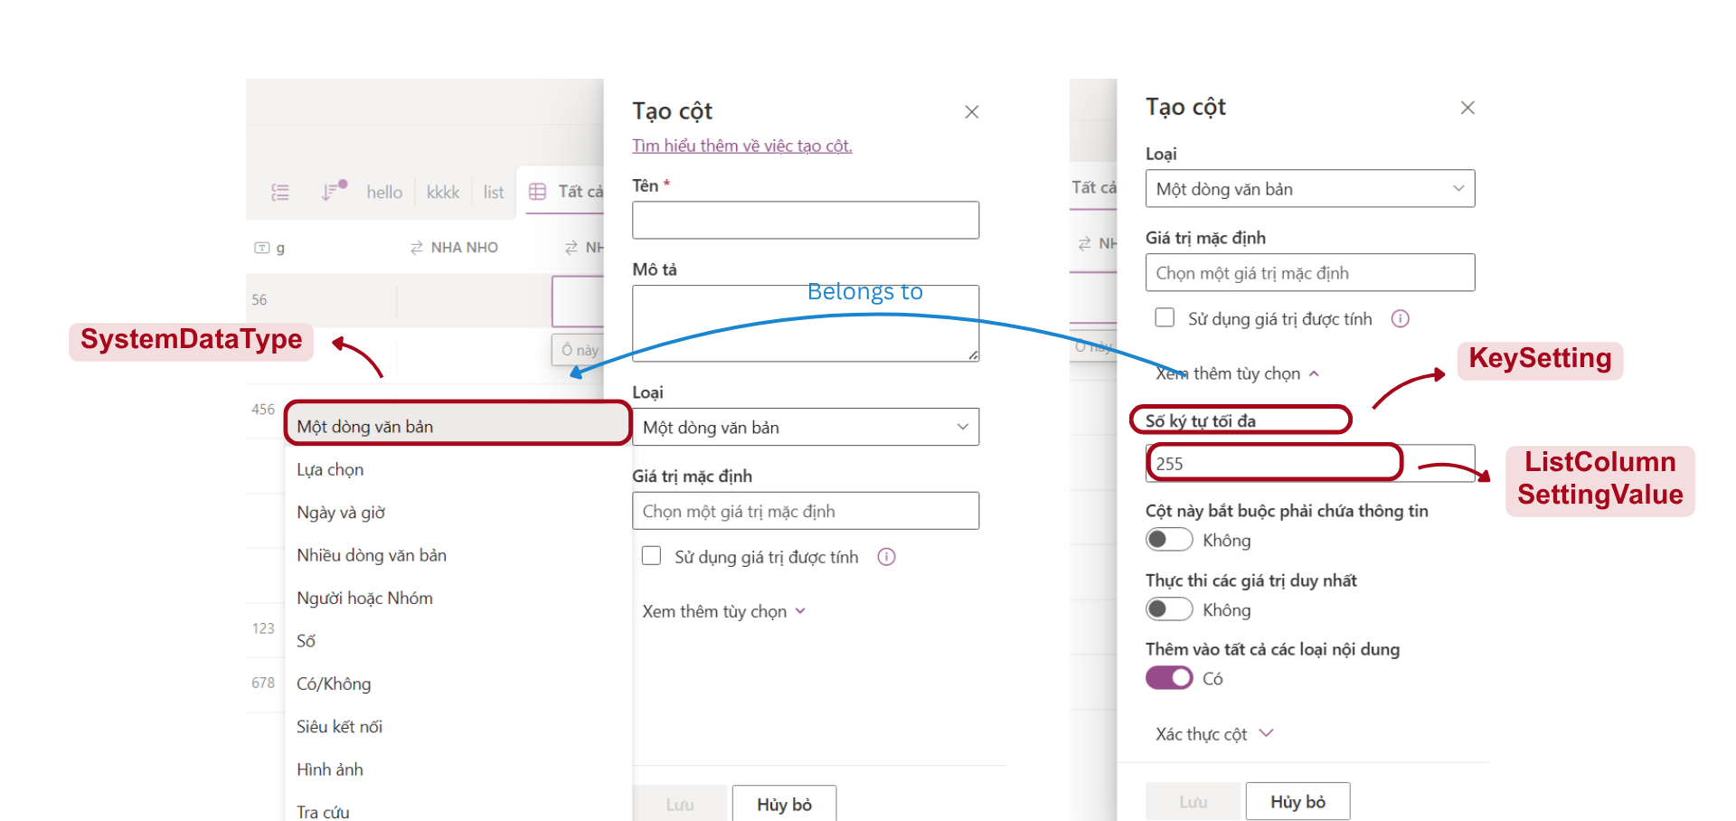
List Column Setting
Notes:
-- 2. Display Key Settings corresponding to that Data Type.
DECLARE @SystemDataTypeId INT = 1;
SELECT
sd.DisplayName,
ks.KeyName,
ks.ValueType
FROM KeySetting ks
JOIN DataTypeSettingKey dsk ON ks.Id = dsk.KeySettingId
JOIN SystemDataType sd ON dsk.SystemDataTypeId = sd.Id
WHERE dsk.SystemDataTypeId = @SystemDataTypeId
GO

Slide 26
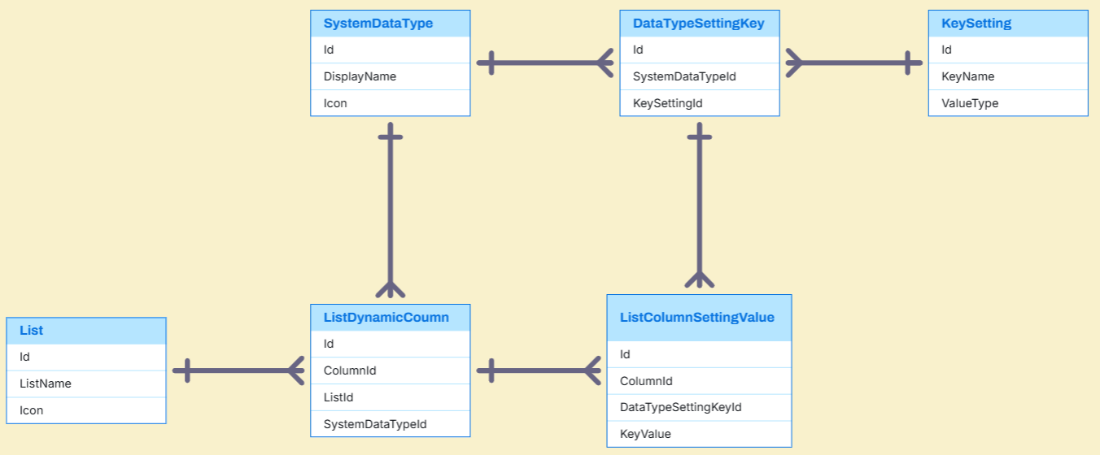
List Column Setting Entities

Slide 27
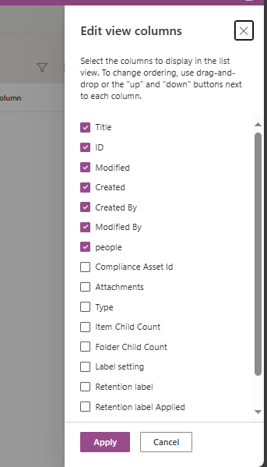
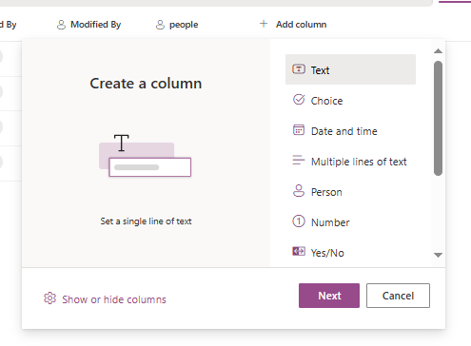
System column
System columns
Notes:
-- 4. Display all Dynamic Columns
DECLARE @ListId INT = 2;
SELECT
dc.ColumnName,
dc.IsVisible,
dc.DisplayOrder
FROM ListDynamicColumn dc
WHERE dc.ListId = @ListId
ORDER BY dc.DisplayOrder;
GO

Slide 28
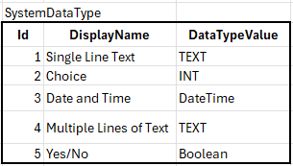
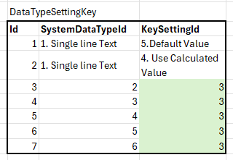
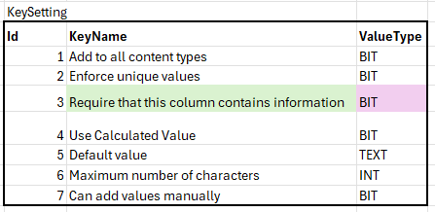
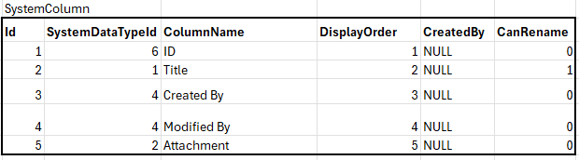
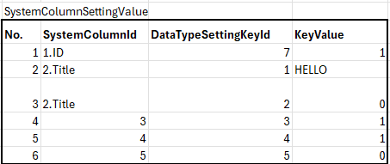
System Column example data

Slide 29
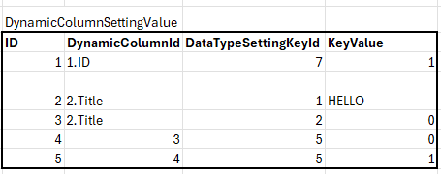
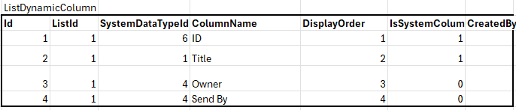
Dynamic Column example data

Slide 30
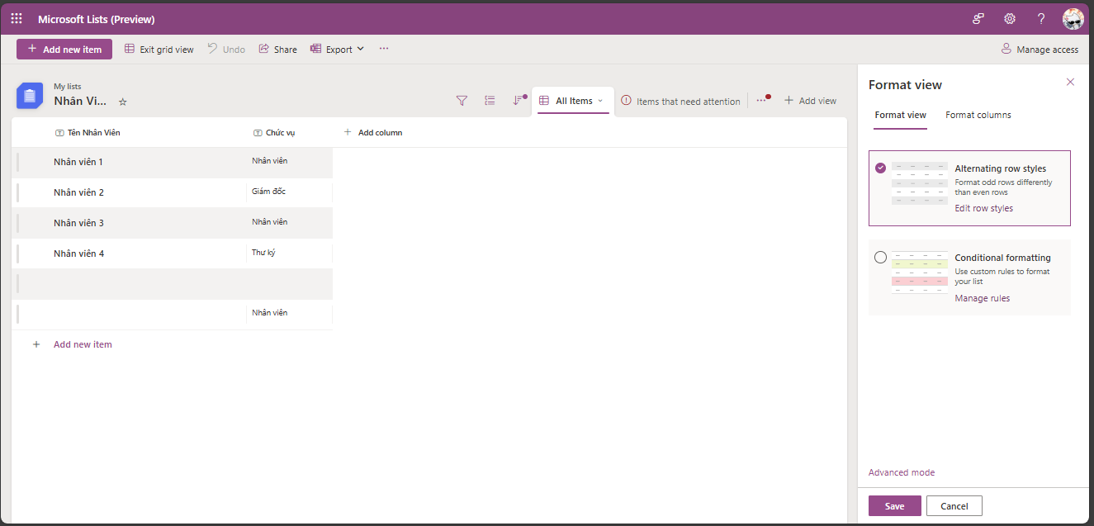
Format View

Slide 31
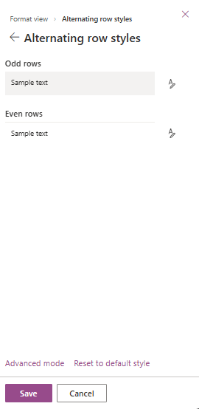
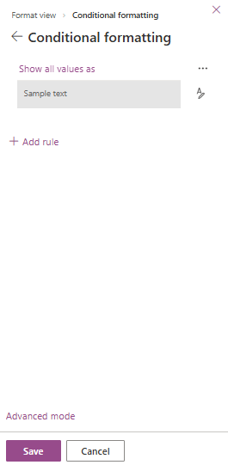
Format View

Slide 32
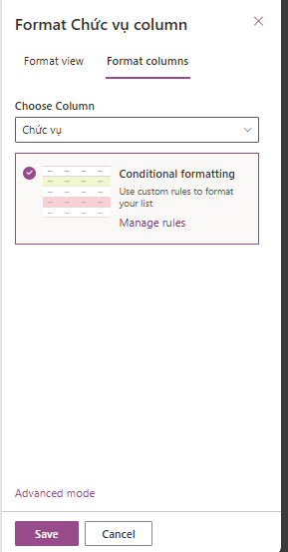
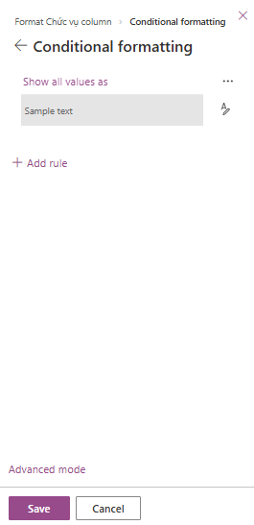
Format Column

Slide 33
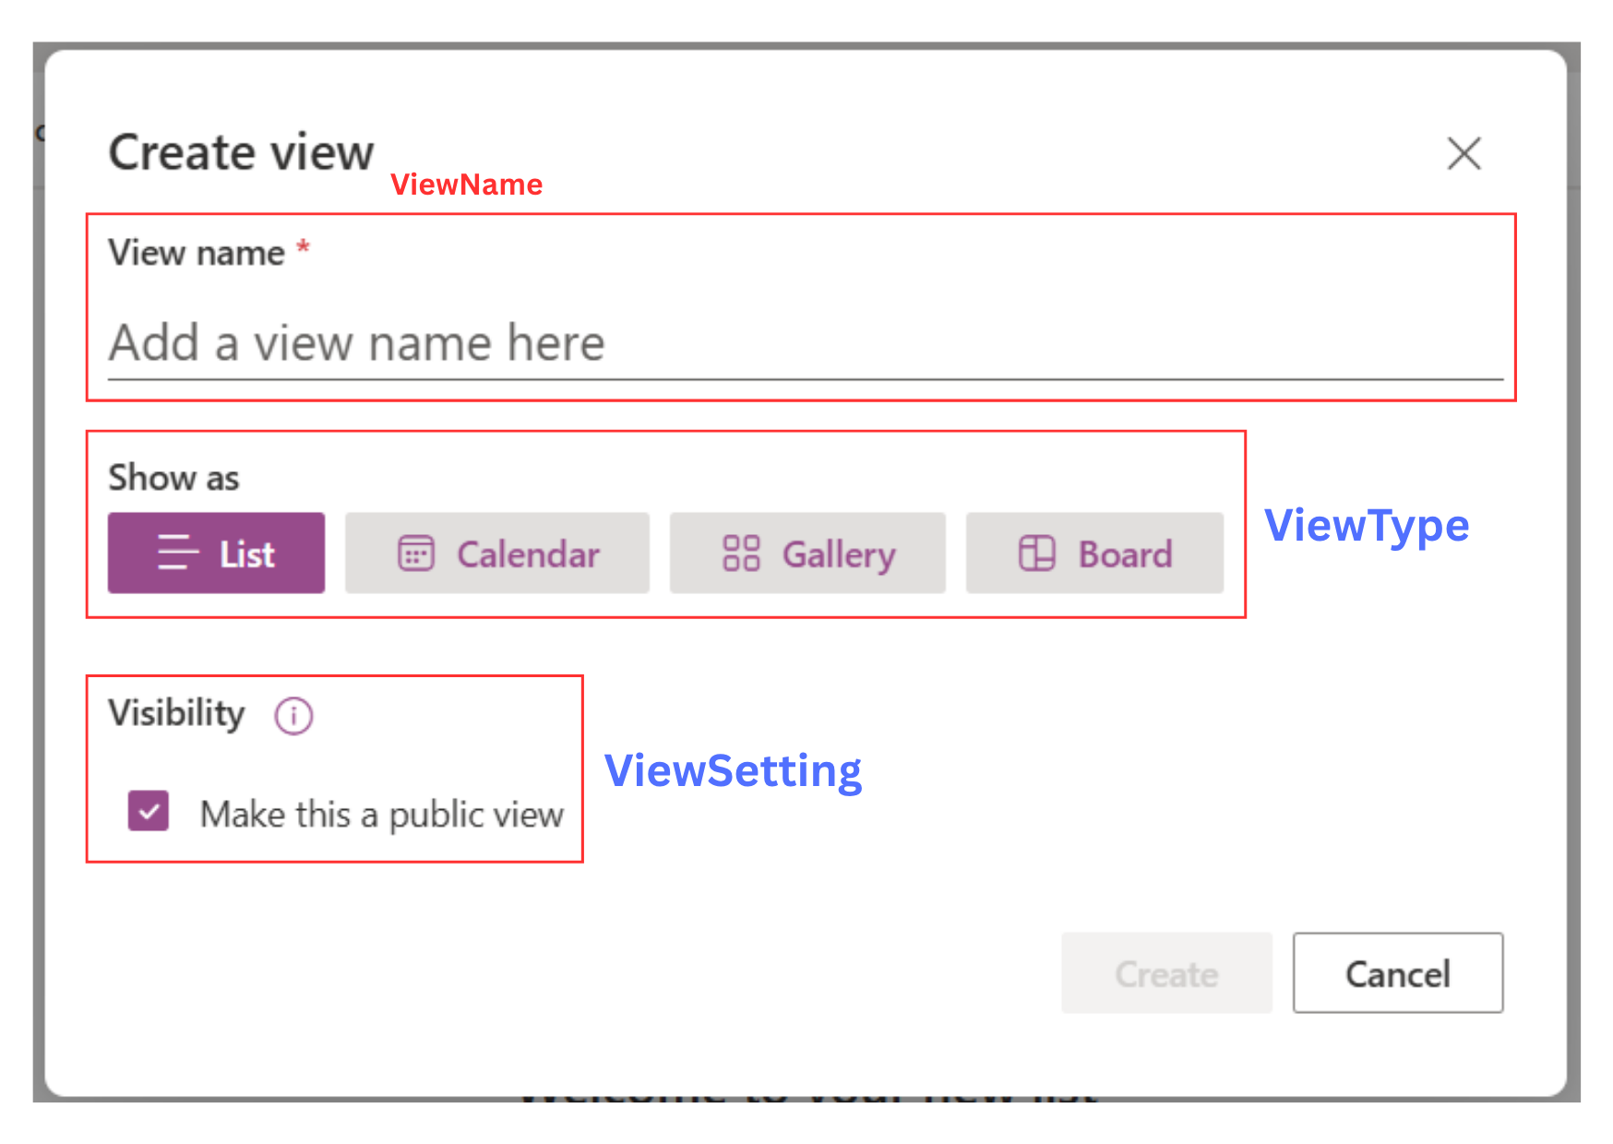
List View

Slide 34
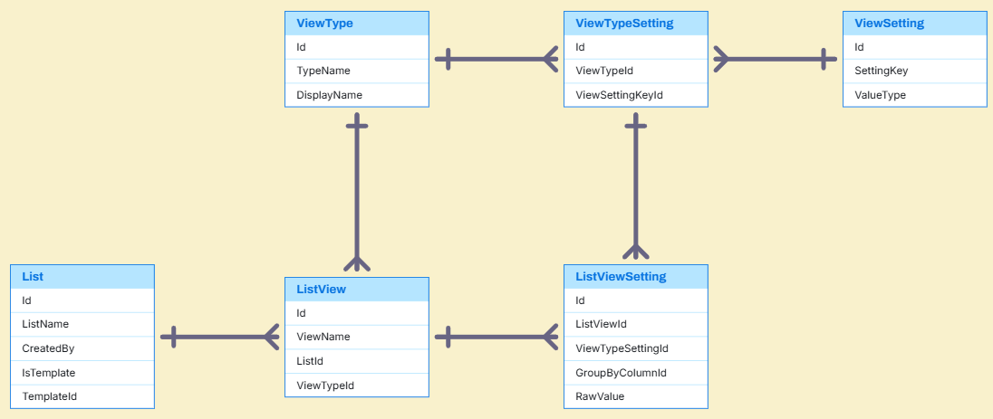
List View Entities

Slide 35
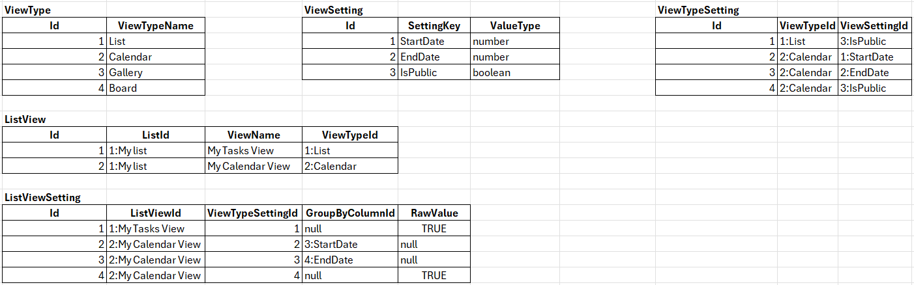
List View Sample Data

Slide 36
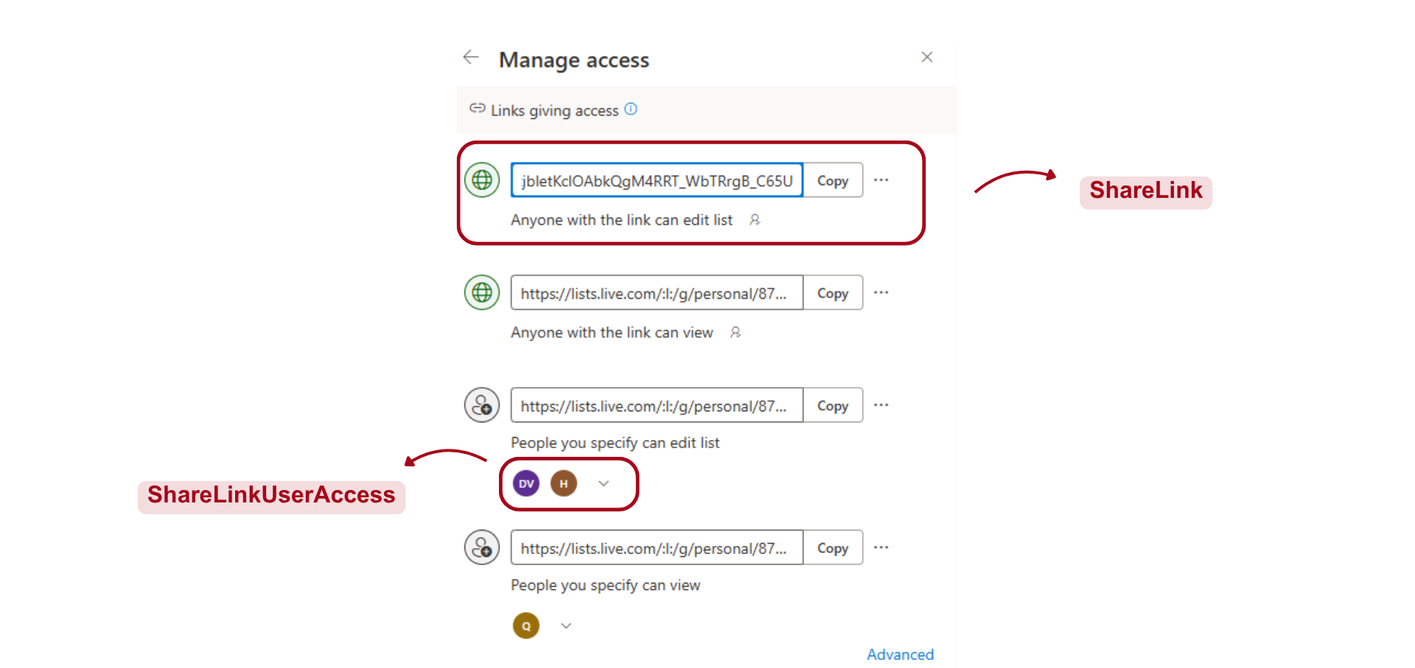
Manage Access

Slide 37
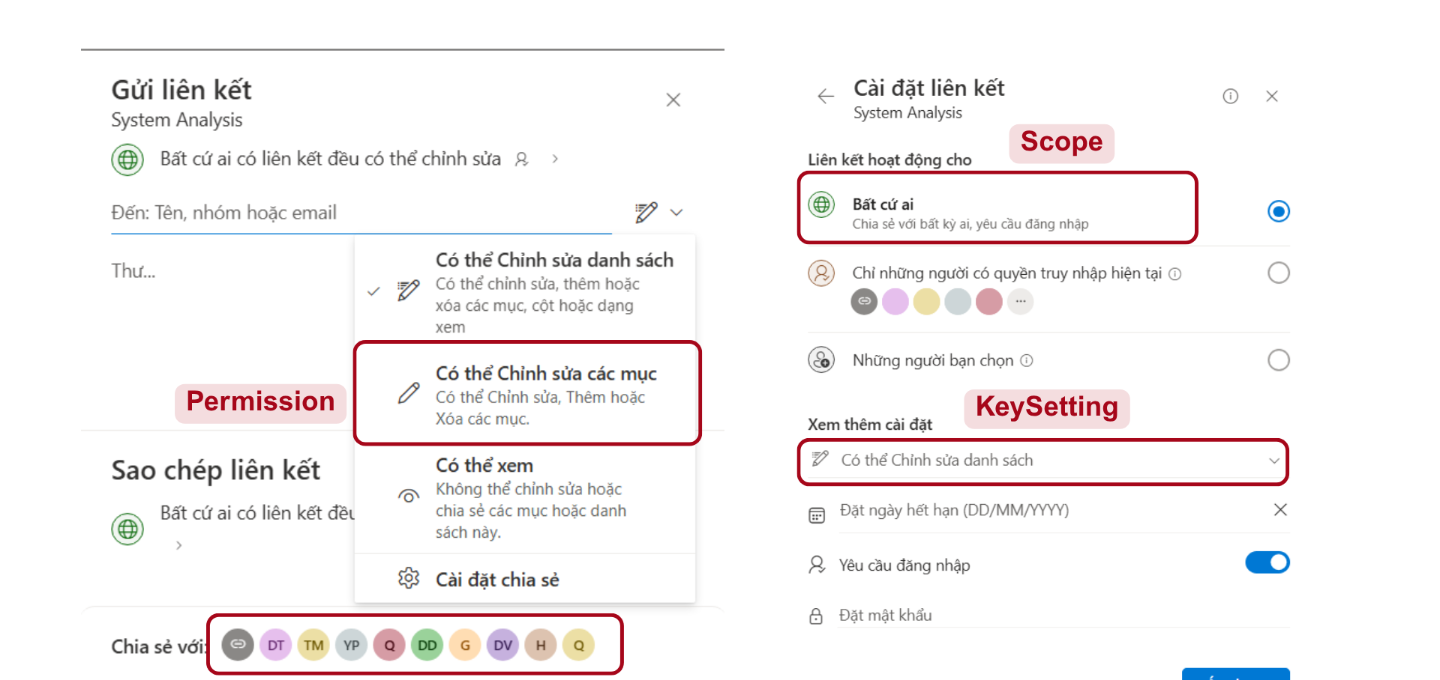
Manage Access

Slide 38
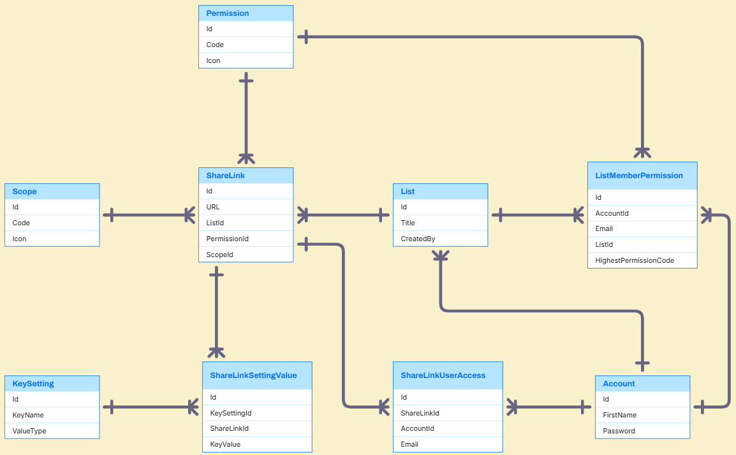
Manage Access Entities

Slide 39
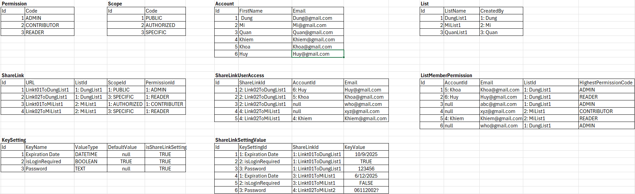
Manage Access Sample Data

Slide 40
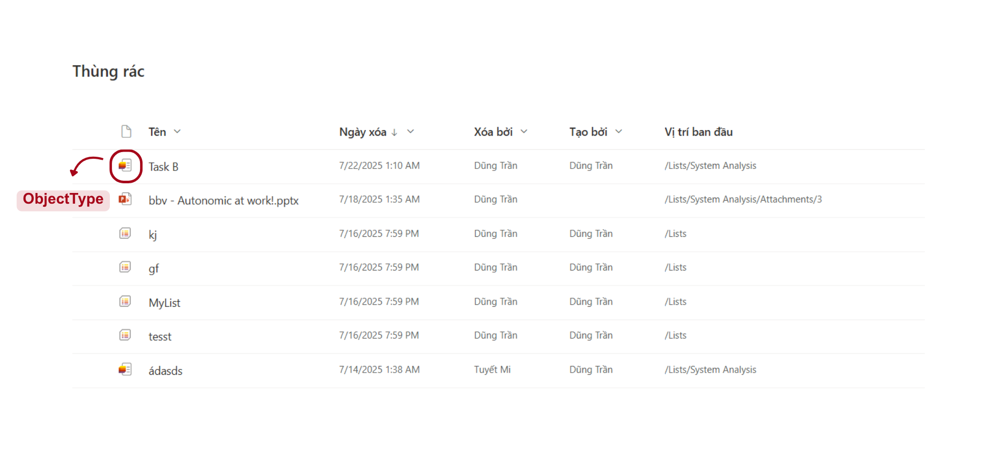
Trash

Slide 41
Q&A

